Slide 1
To run Maya in English on a non-English operating system environment (Windows)
You need to create a new environment variable in the Windows operating system.
Important: You must set the environment variable in the Windows System Preferences, not in the Maya.env file. Changing this variable in the Maya.env files does not affect Maya behavior.
Open the Windows Environment Variables. Depending on your version of windows, the Environment Variables are found different places:
  Pre-Windows 7, locate the My Computer icon, and select Properties from the drop-down list that appears. In the System Properties window, click the Advanced tab and click Environment Variables.
  Windows 7, right-click your computer name and select Properties > Advanced system settings. Click Environment Variables.
  On Windows 10, type Environment Variable in the Windows Search field to open the Environment Variable window.
In the User Variable for <yourname> area, click New.
In the Variable Name text field, type: MAYA_UI_LANGUAGE.
In the Variable Value text field, type: en_US
Launch Maya.
Tip: If, after changing the operating language of Maya, you want to run Maya in Japanese/Simplified Chinese, set your Environment Variable value to ja_JP (for Japanese) and zh_CN (for Simplified Chinese), or remove the variable from the list of environment variables.
To run Maya in English within a non-English OS environment (Mac OS X)
Click the System Preferences icon.
Select Language & Region.
Add your preferred non-English language to the Preferred languages.
Select the new language as your primary language for your OS.
Restart your computer.
Launch Maya.

Slide 2
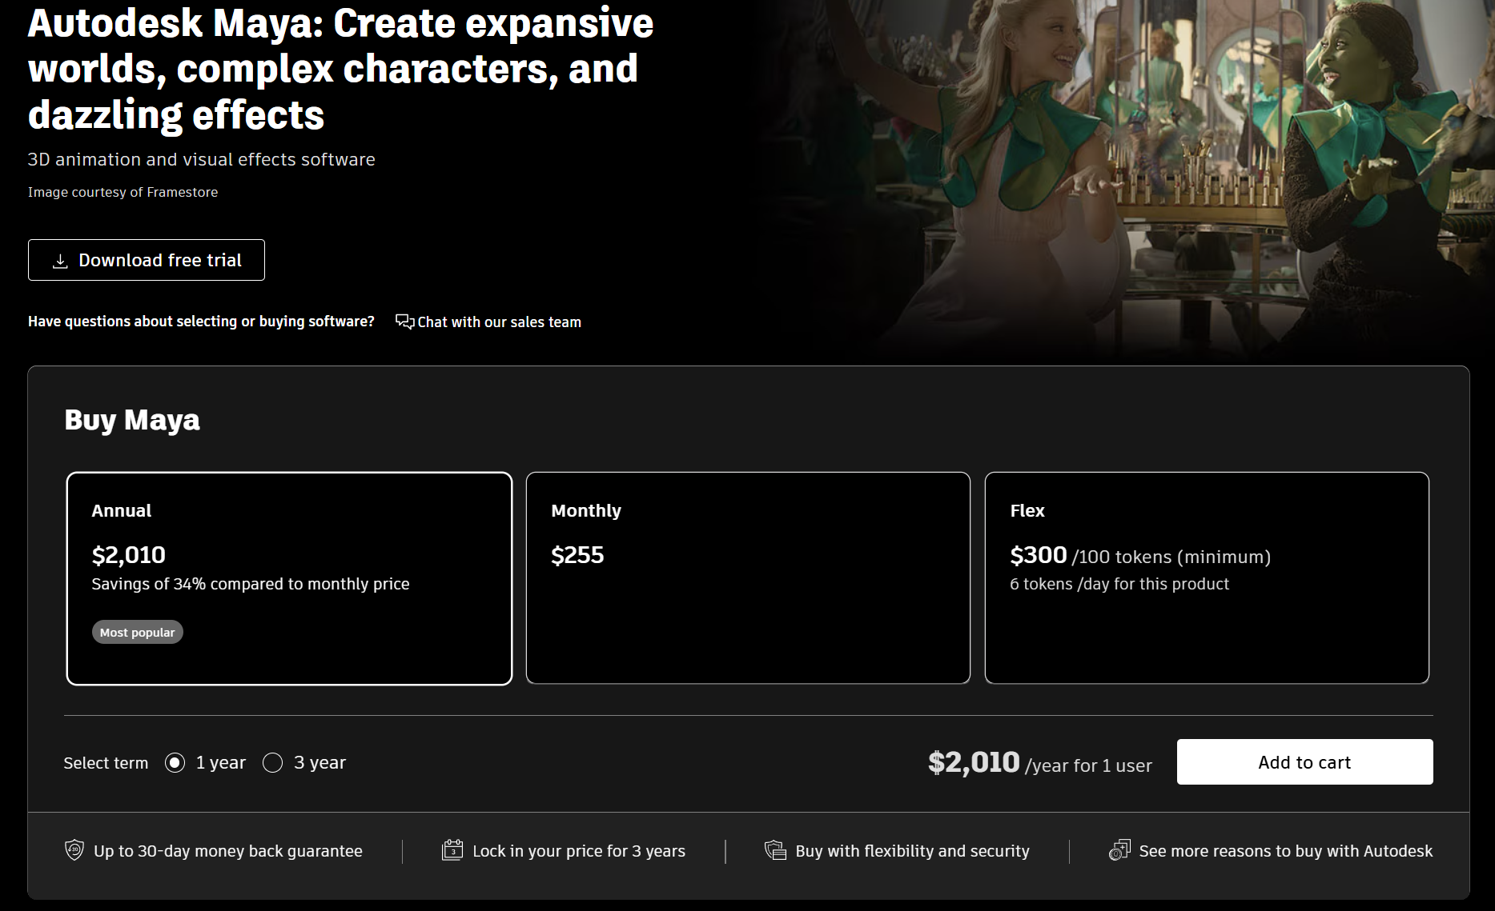


Slide 3
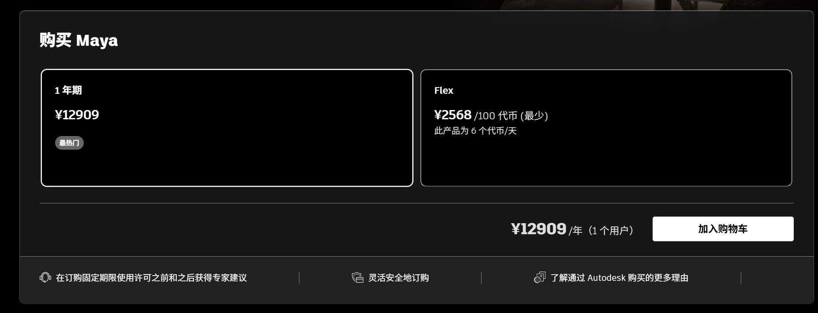

Slide 4
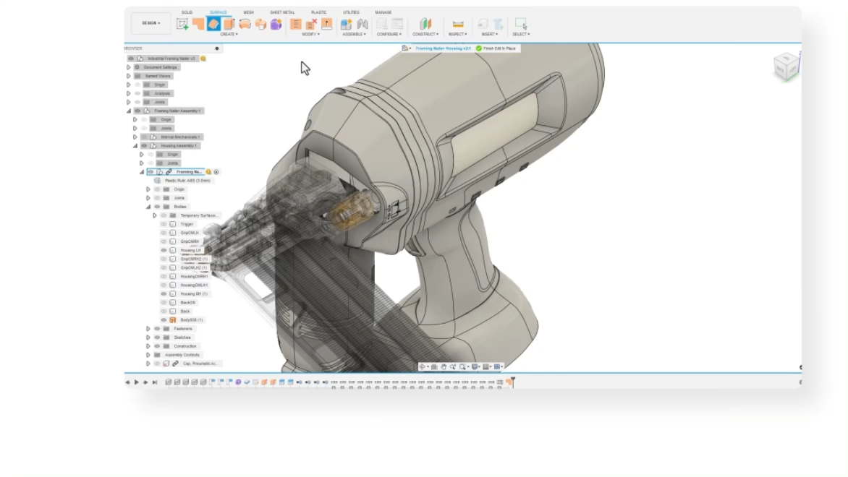

Slide 5


Slide 6
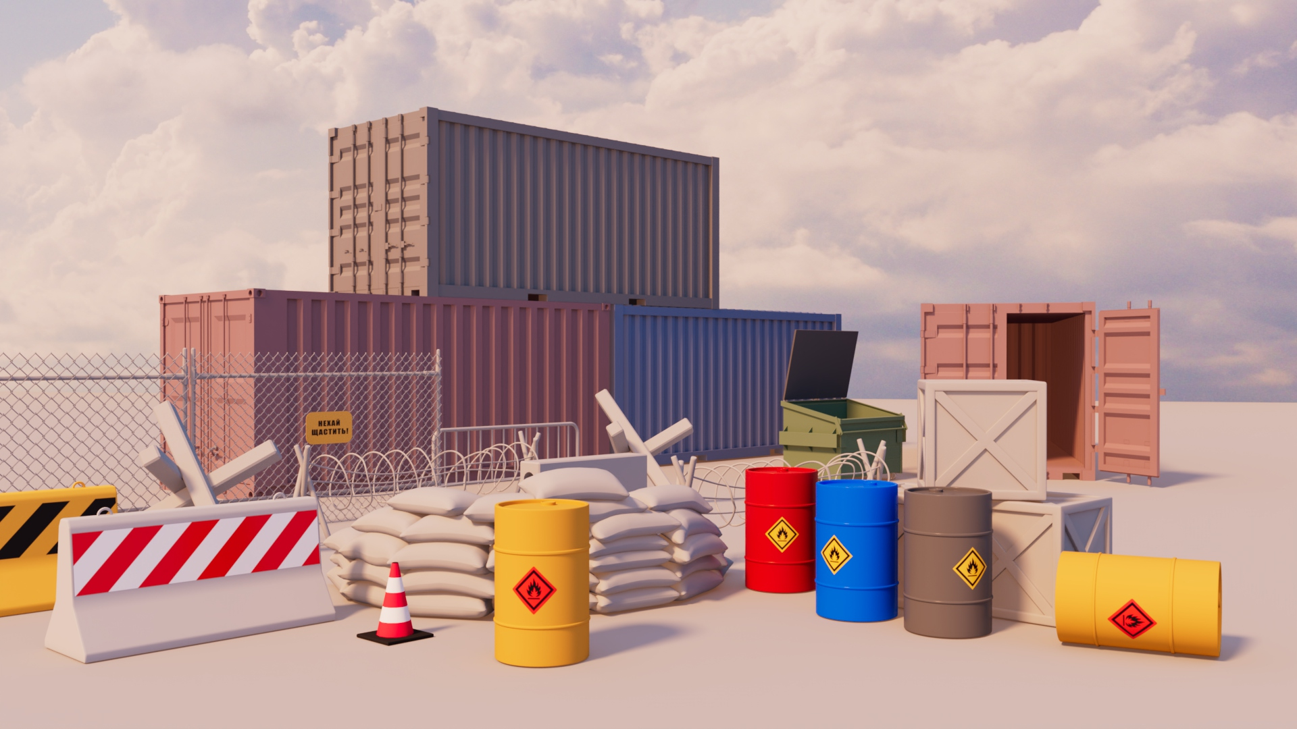

Slide 7
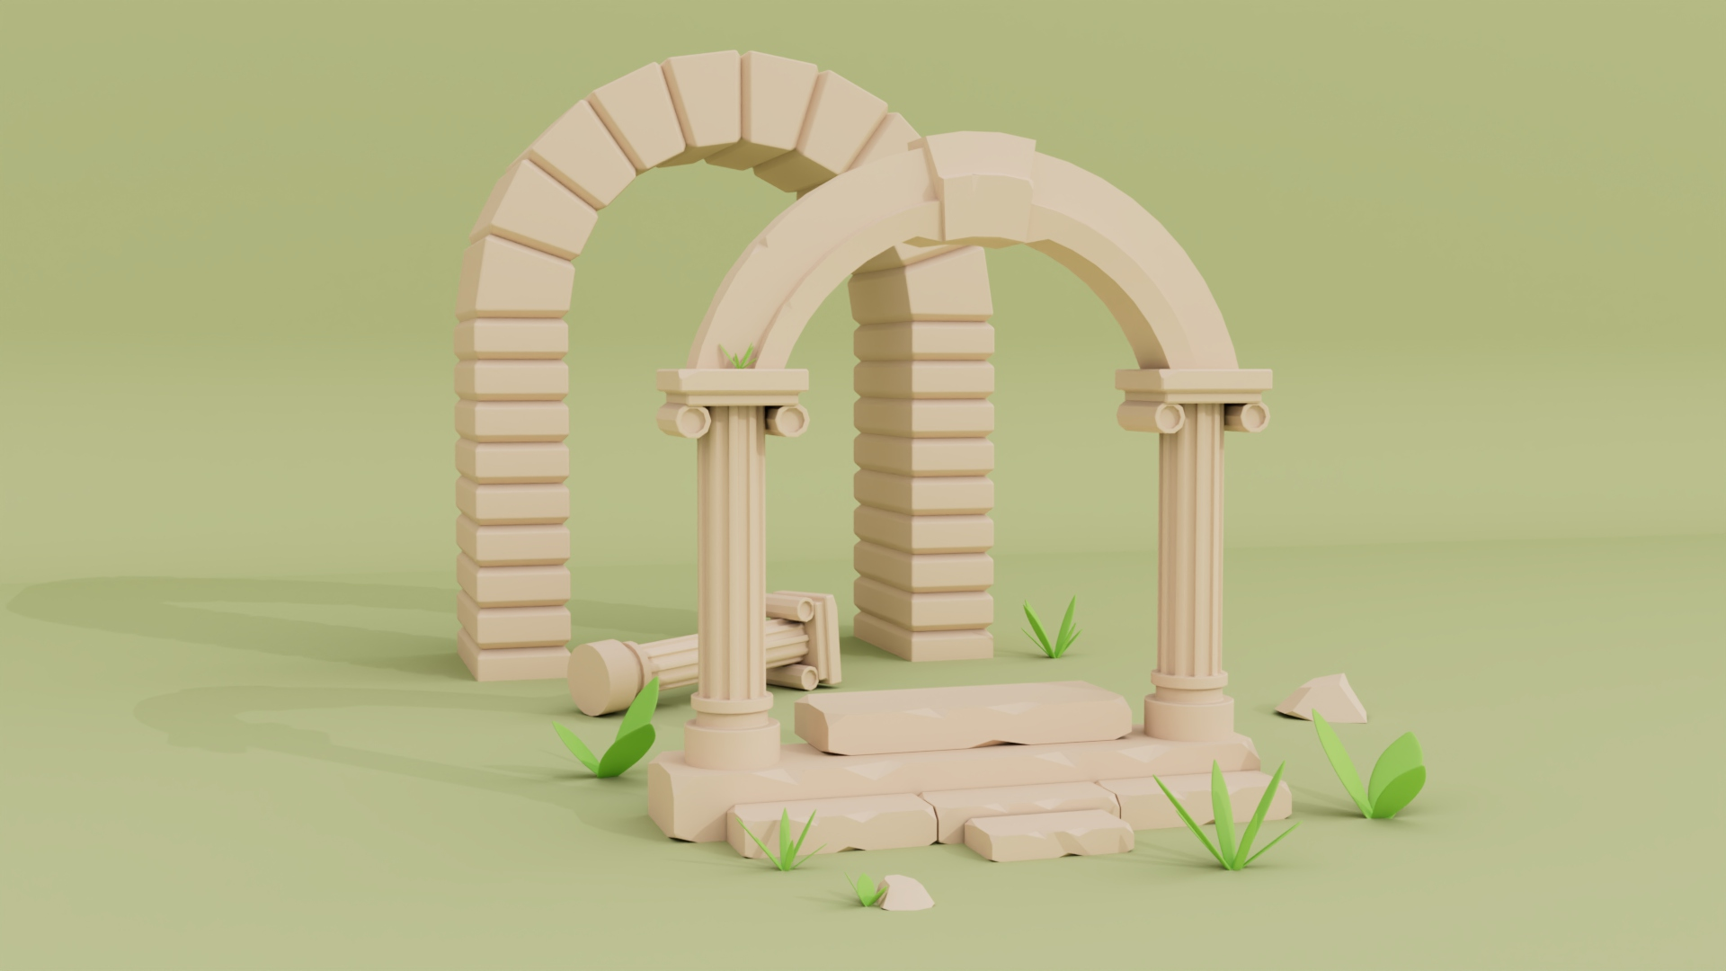

Slide 8


Slide 9
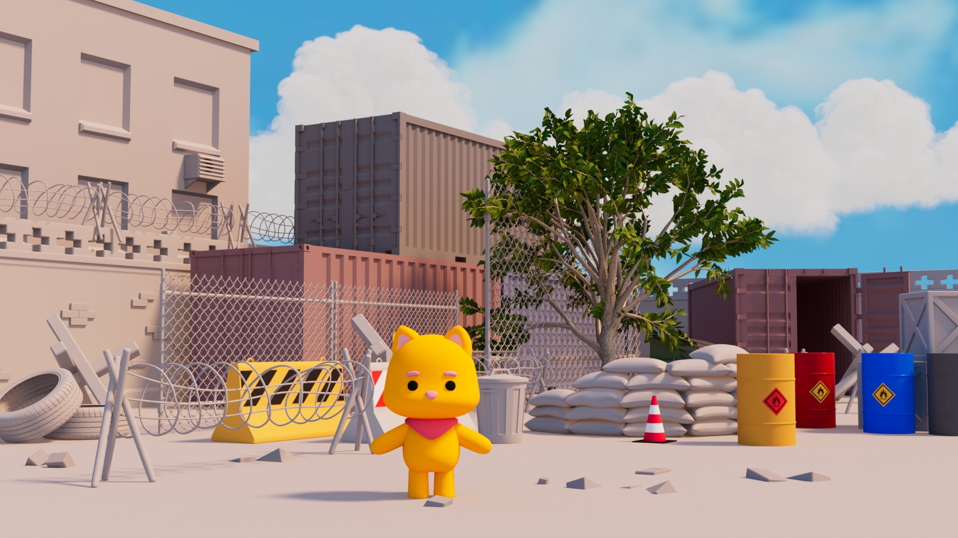

Slide 10
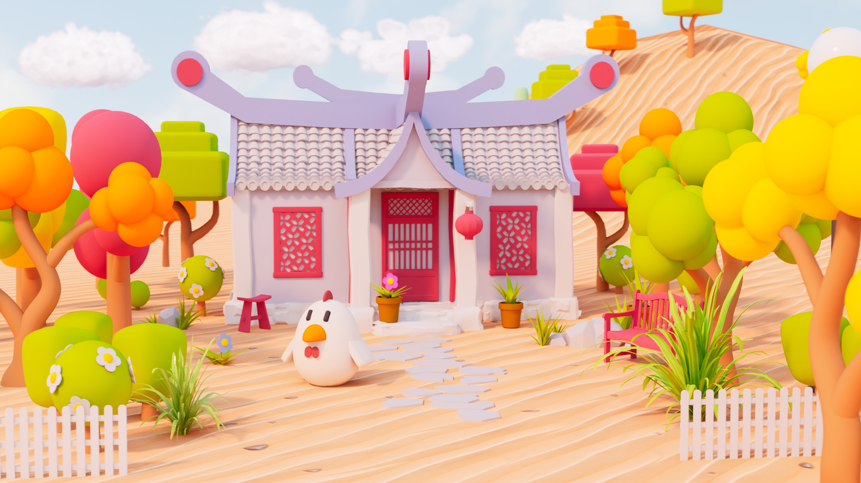

Slide 11
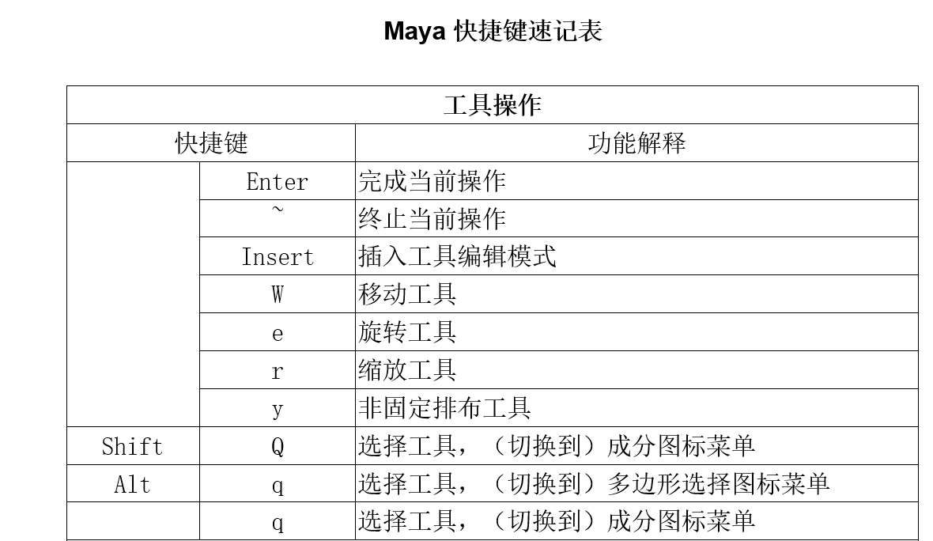

Slide 12
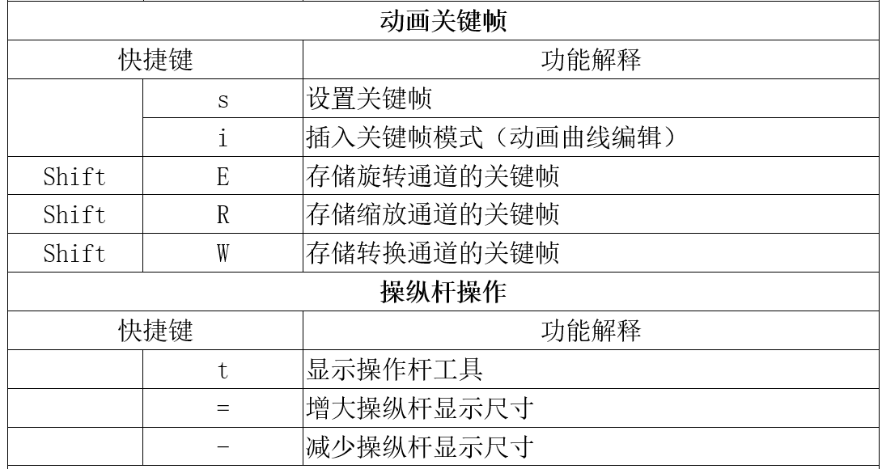

Slide 13
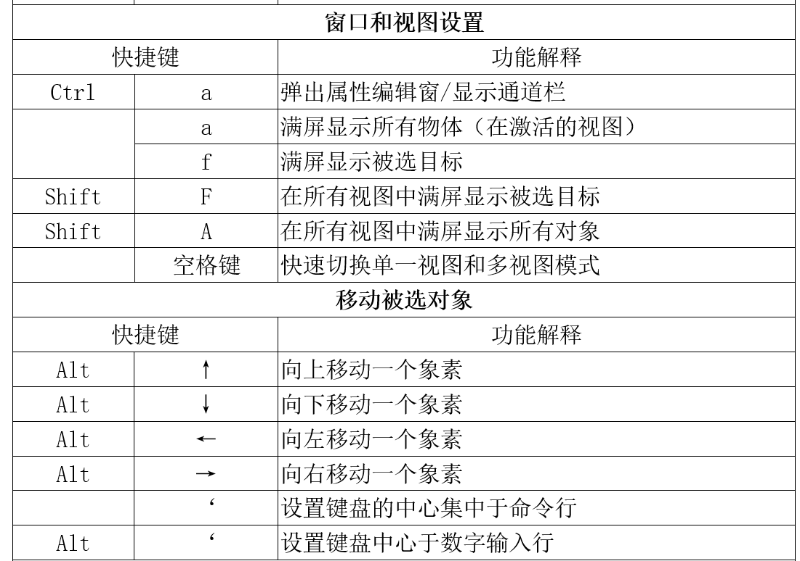

Slide 14
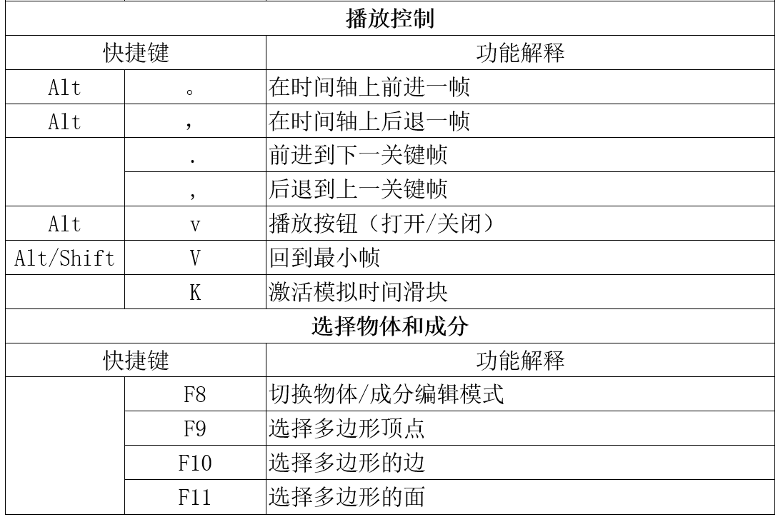

Slide 15
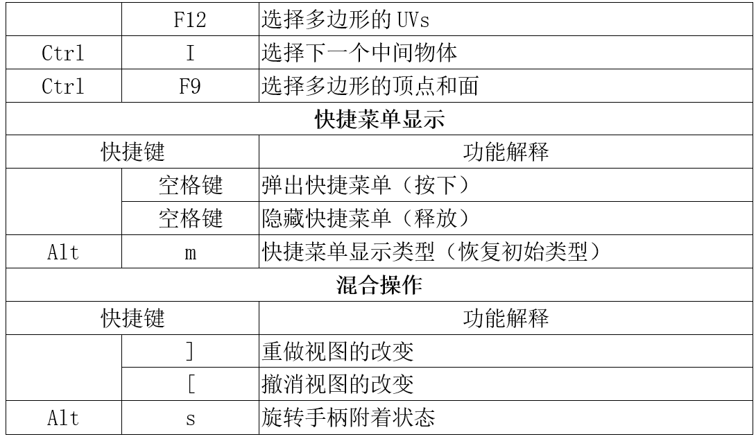

Slide 16
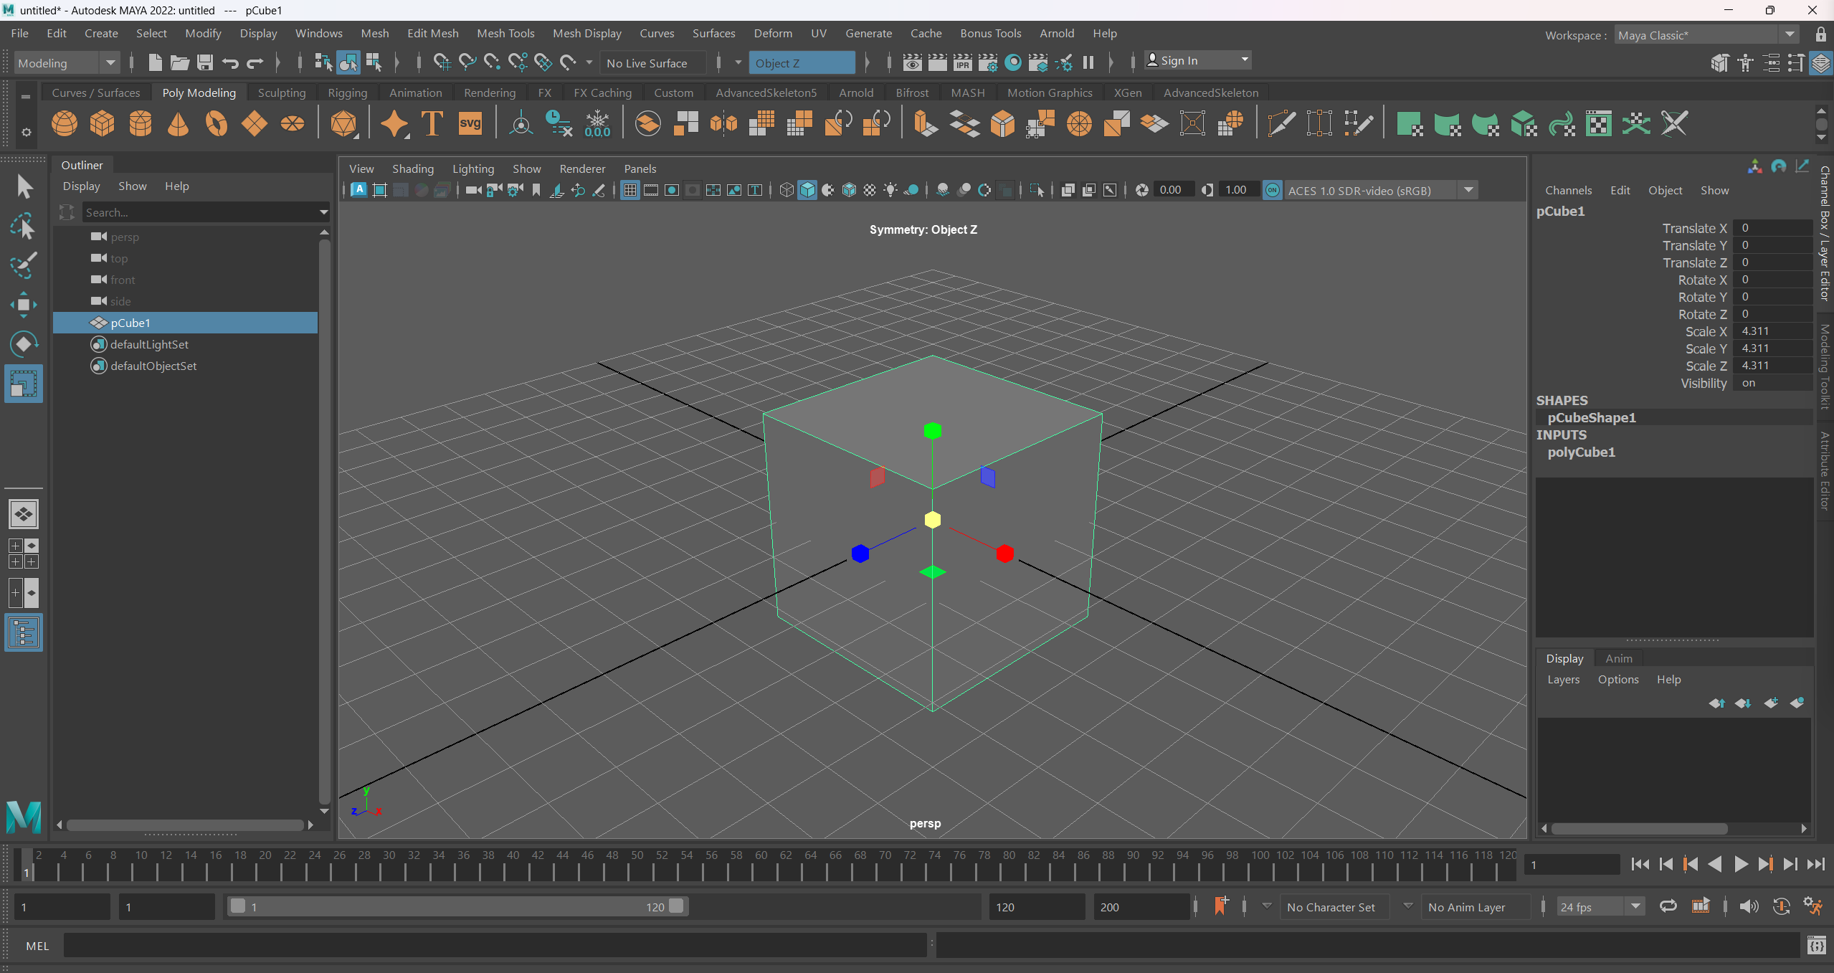


Slide 17
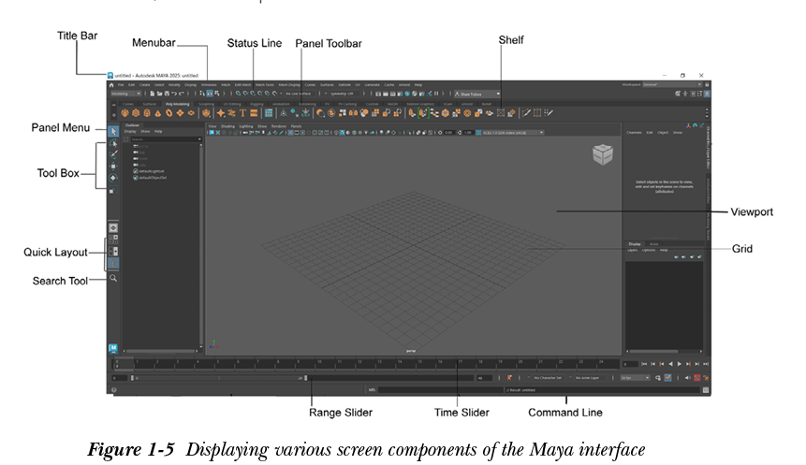

Slide 18
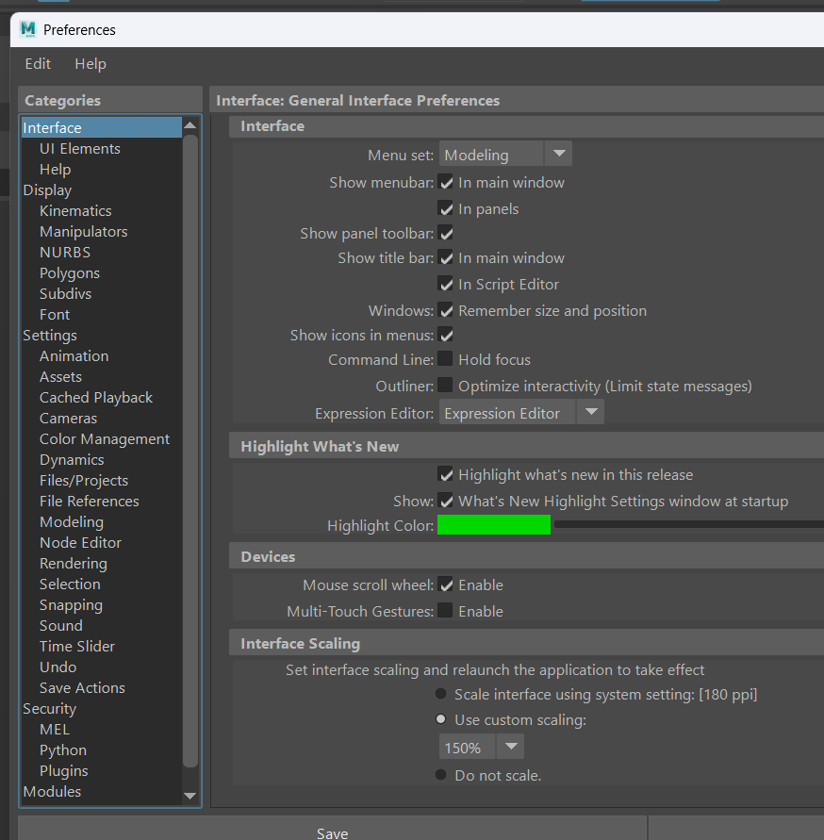


Slide 19
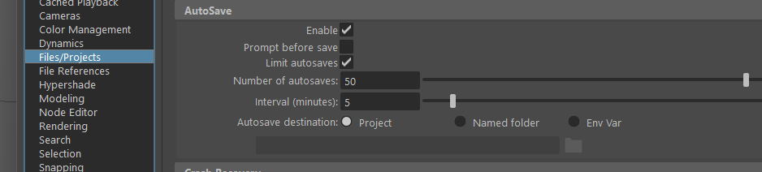


Slide 20
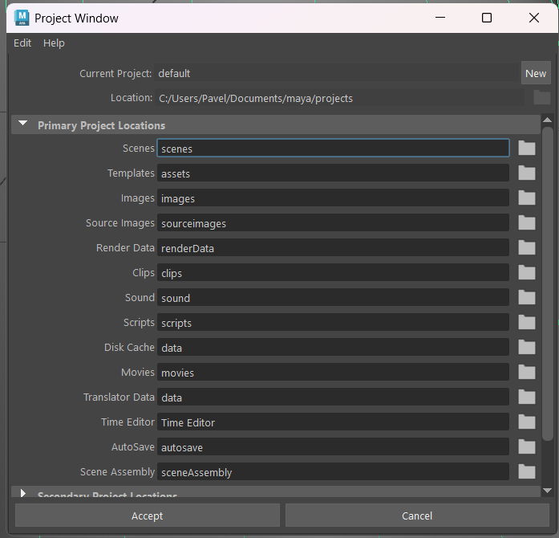

Slide 21
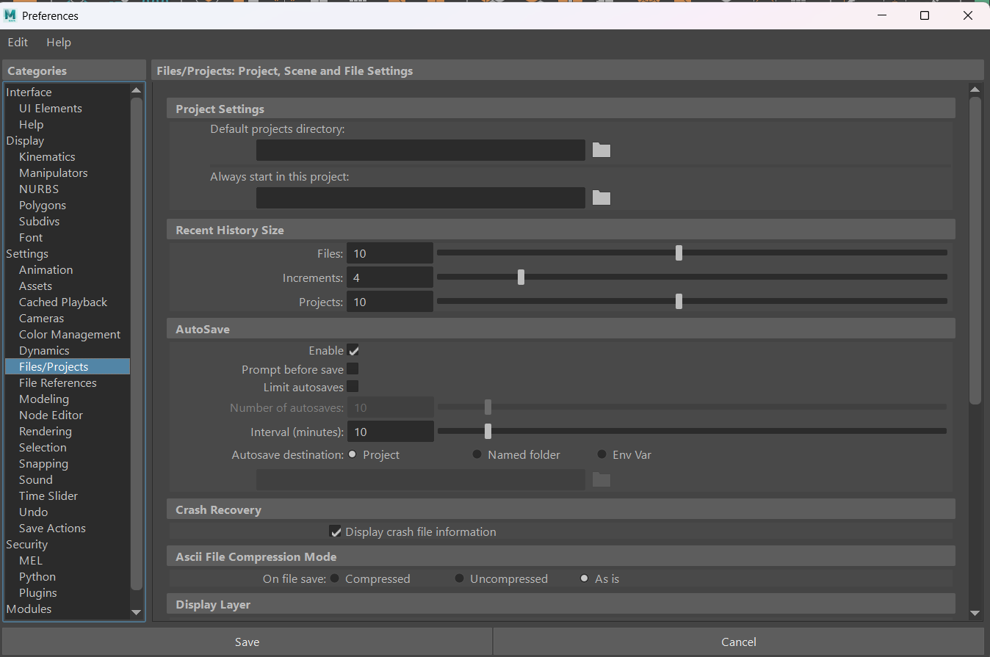
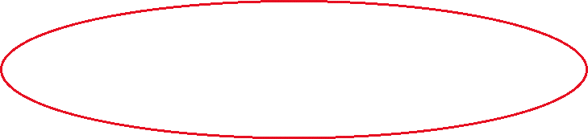

Slide 22
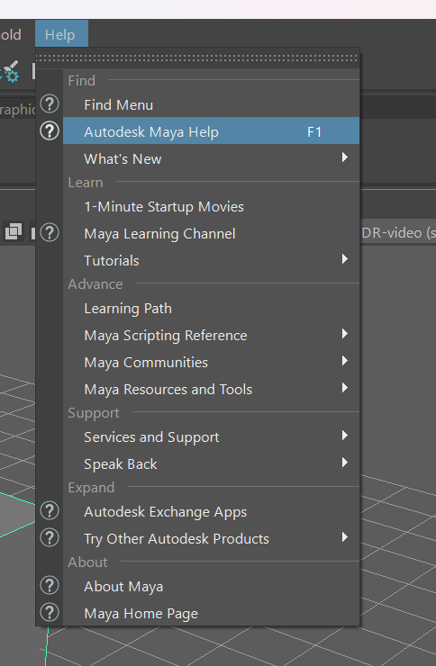

Slide 23
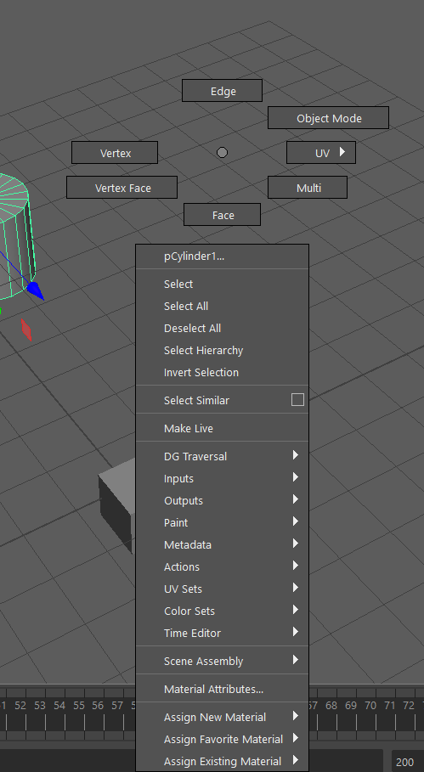

Slide 24
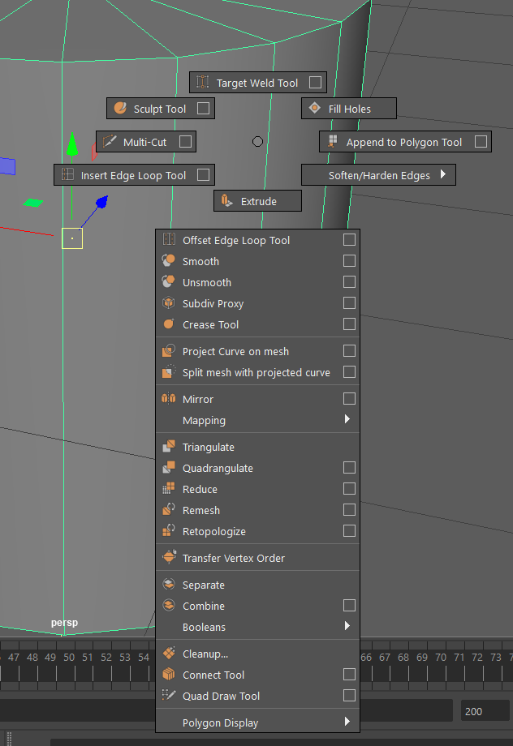

Slide 25
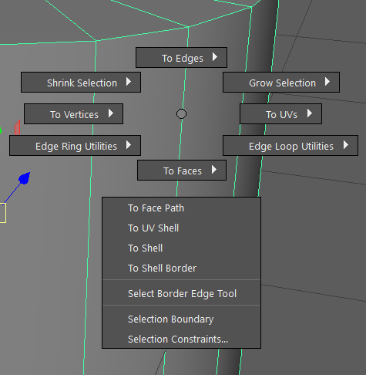

Slide 26
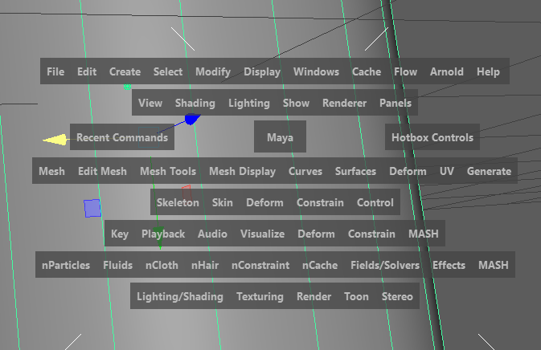

Slide 27
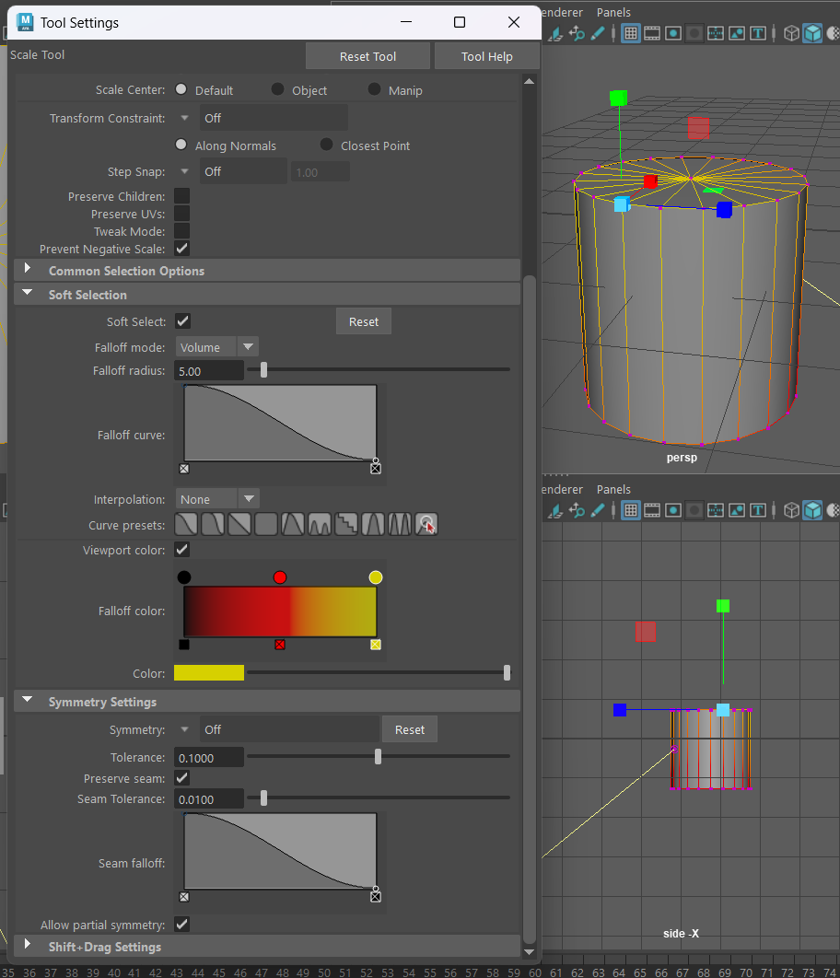



Slide 28
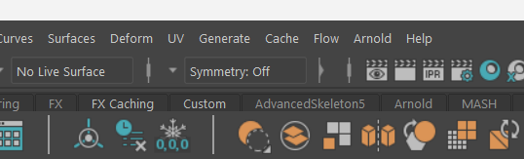


Slide 30
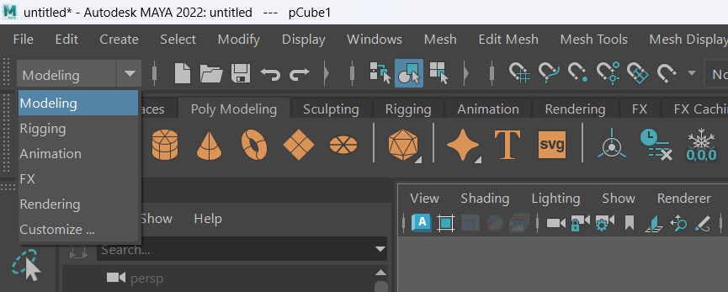

Slide 31
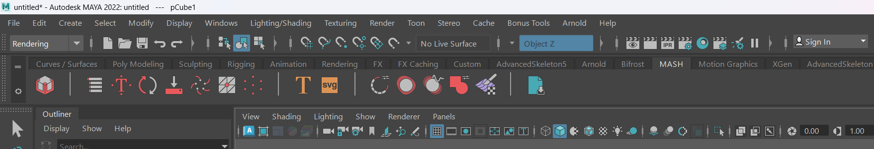

Slide 34
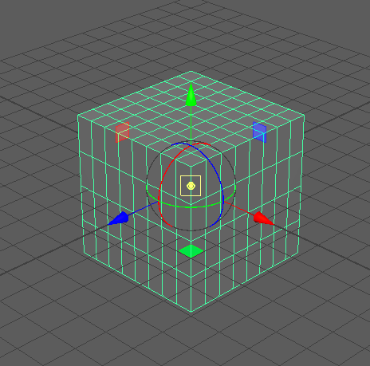
CTRL + D

Slide 35
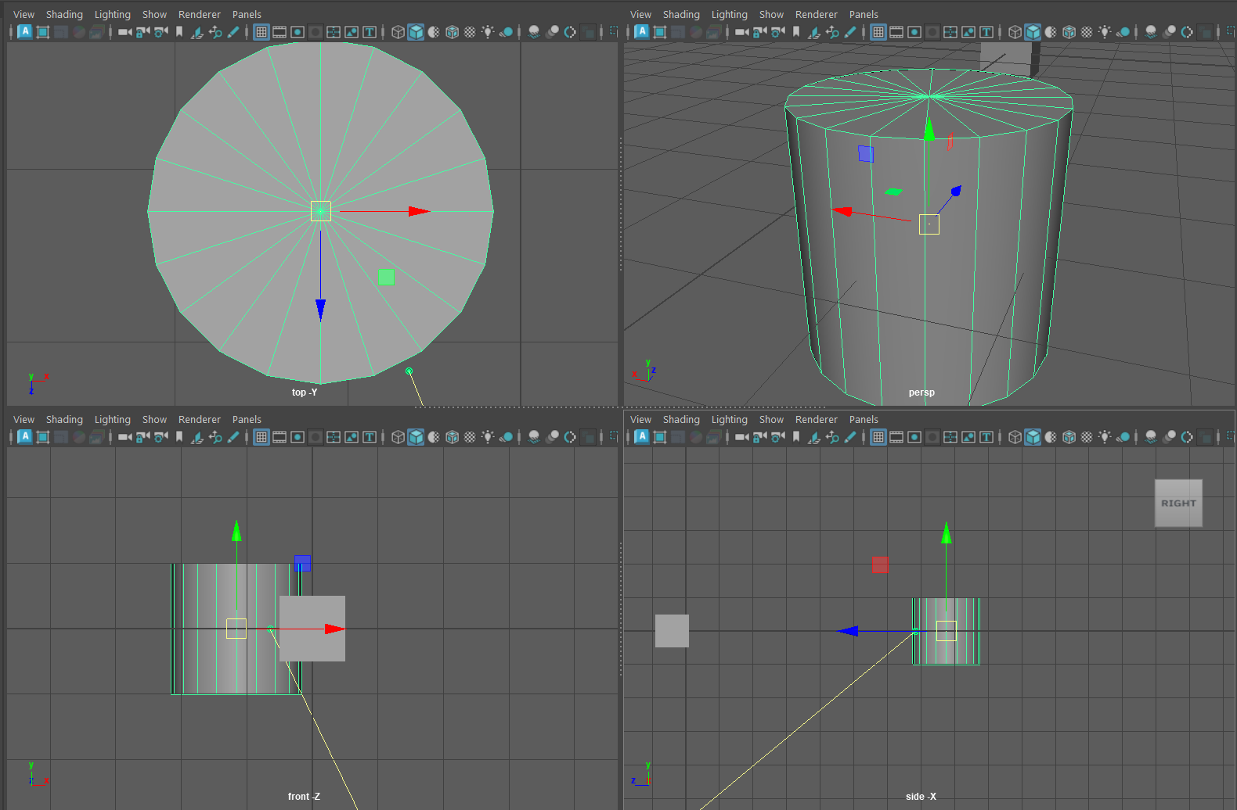

Slide 36
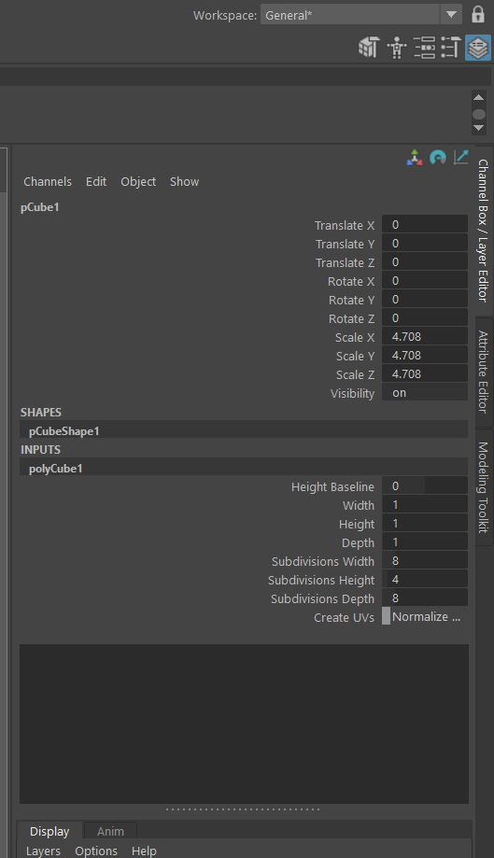

Slide 37
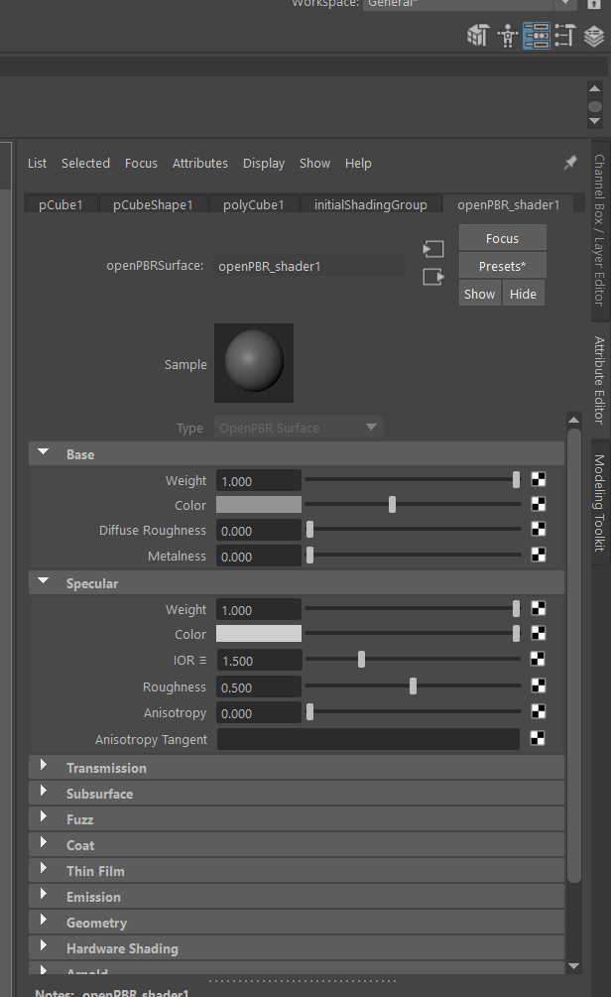

Slide 38
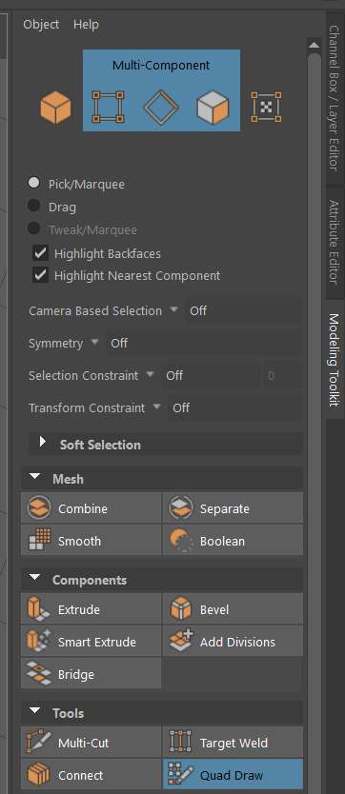

Slide 39
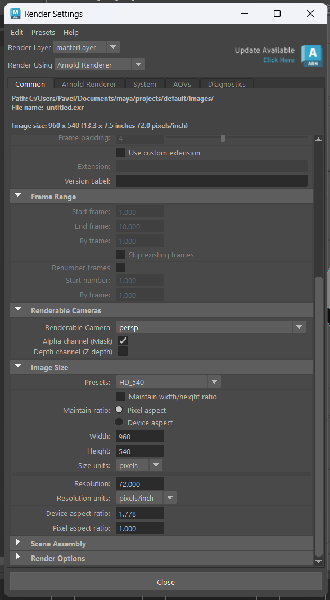

Slide 40
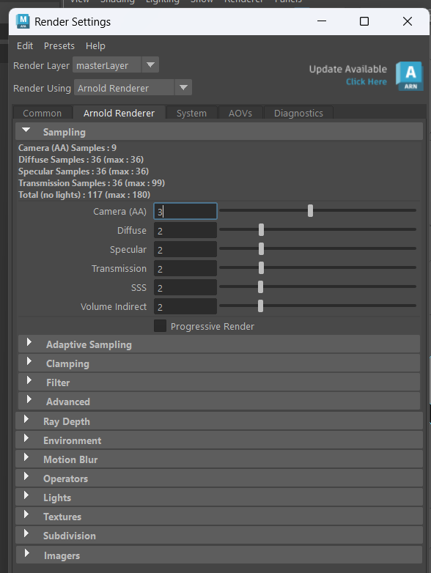

Slide 41
